Slide 1
Machine Learning I MATH80629A Apprentissage Automatique I MATH80629
Attention and Transformers — Week #6

Slide 2
Transformers
The architecture

Slide 3
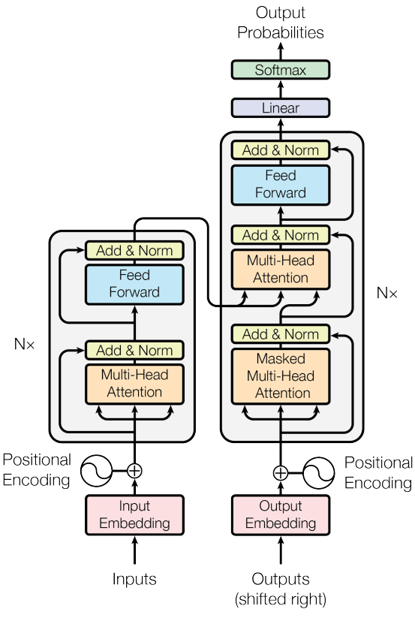

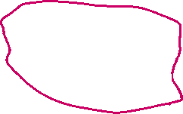
Transformers
Vaswani, Ashish, et al. "Attention is all you need." Advances in neural information processing systems 30 (2017).

Slide 4
Transformers
Applications

Slide 5
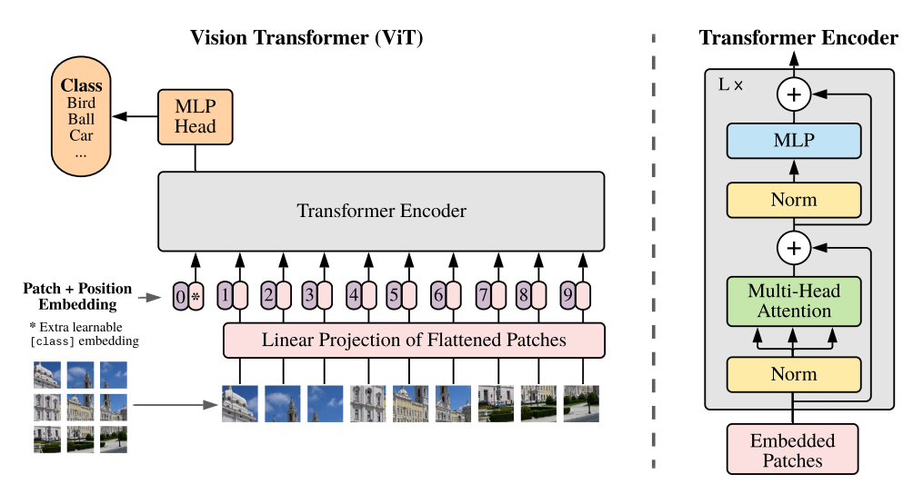

Vision Transformers
Dosovitskiy, Alexey, et al. "An image is worth 16x16 words: Transformers for image recognition at scale." arXiv preprint arXiv:2010.11929 (2020).

Slide 6
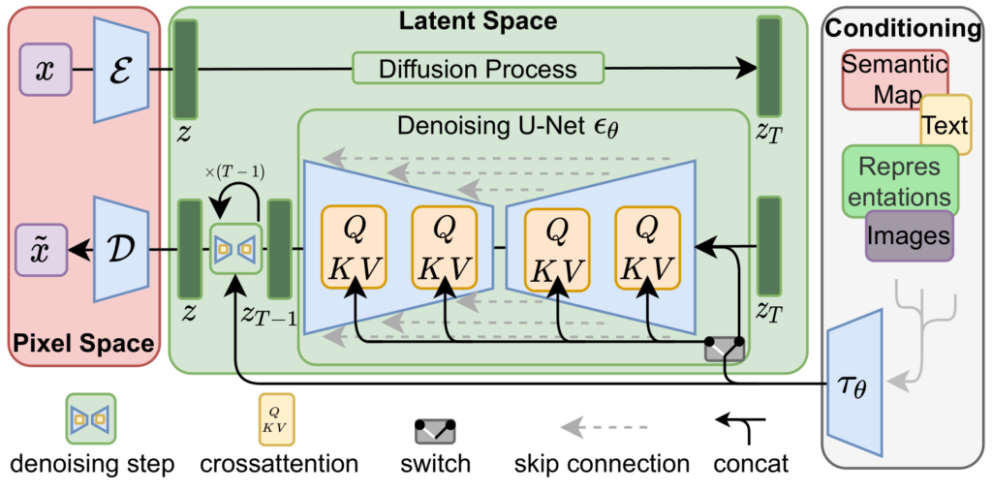




Stable diffusion
Rombach, Robin, et al. "High-resolution image synthesis with latent diffusion models." Proceedings of the IEEE/CVF conference on computer vision and pattern recognition. 2022.

Slide 7
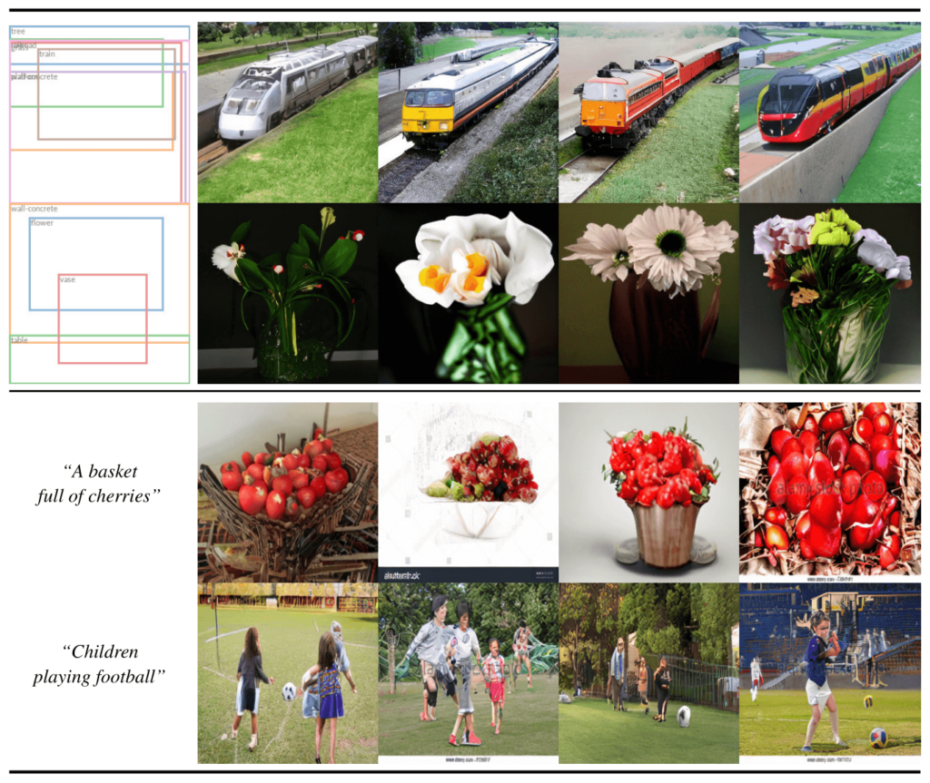





Stable diffusion
Rombach, Robin, et al. "High-resolution image synthesis with latent diffusion models." Proceedings of the IEEE/CVF conference on computer vision and pattern recognition. 2022.

Slide 8
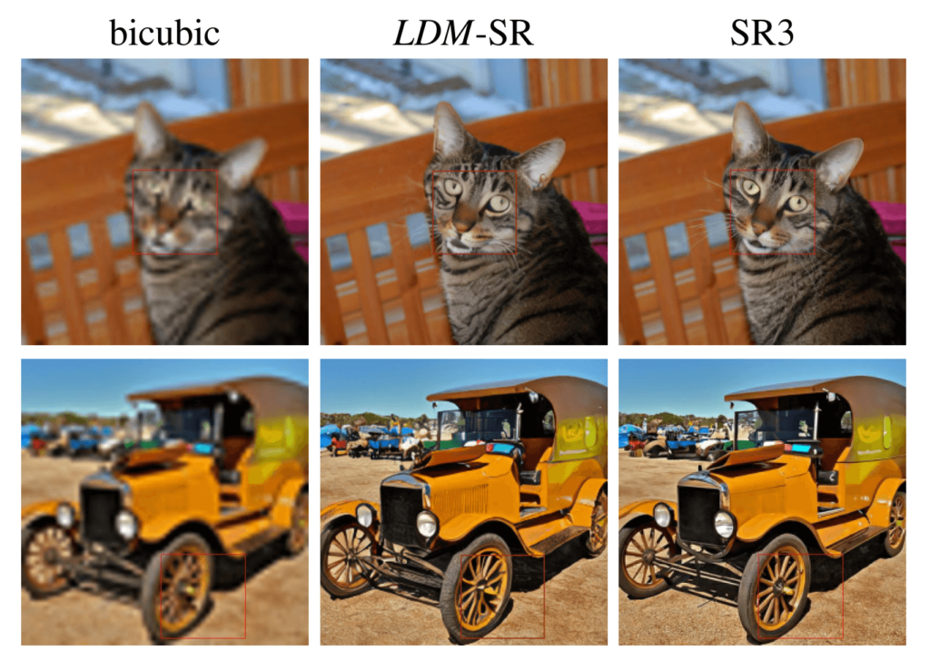
Stable diffusion
Rombach, Robin, et al. "High-resolution image synthesis with latent diffusion models." Proceedings of the IEEE/CVF conference on computer vision and pattern recognition. 2022.

Slide 9
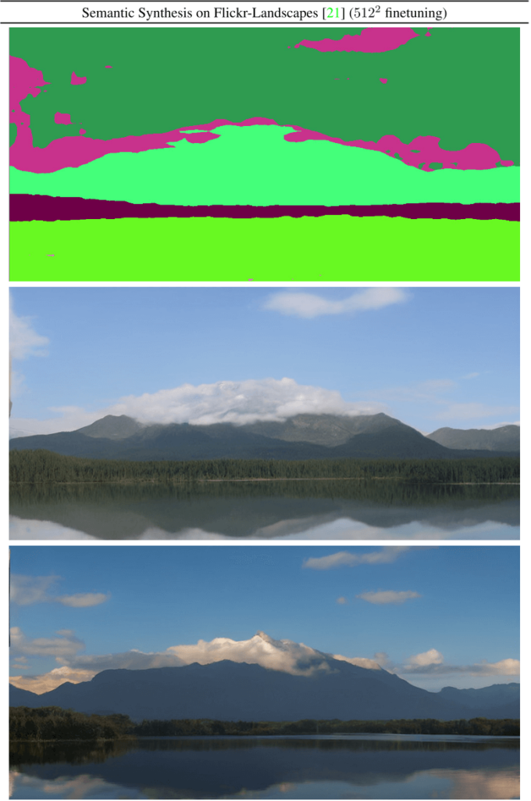





Stable diffusion
Rombach, Robin, et al. "High-resolution image synthesis with latent diffusion models." Proceedings of the IEEE/CVF conference on computer vision and pattern recognition. 2022.

Slide 10
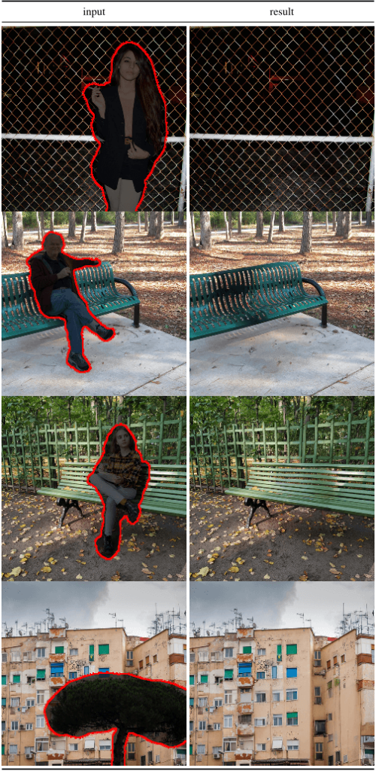




Stable diffusion
Rombach, Robin, et al. "High-resolution image synthesis with latent diffusion models." Proceedings of the IEEE/CVF conference on computer vision and pattern recognition. 2022.

Slide 11
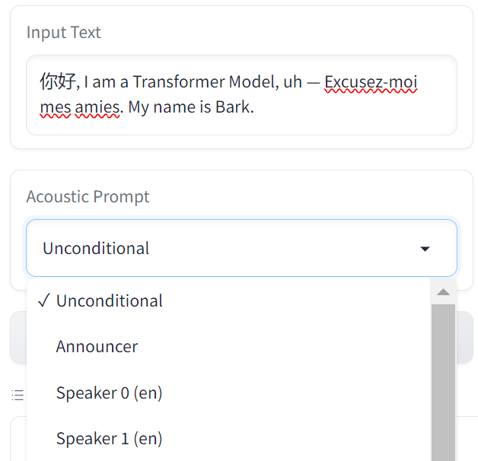
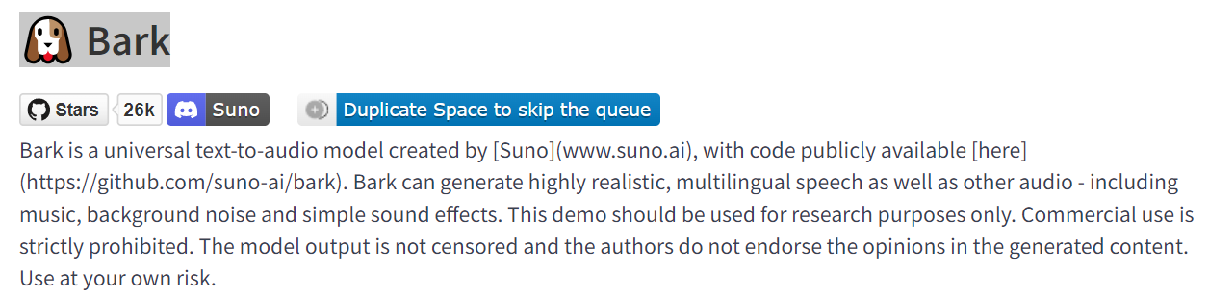


Speech
https://github.com/suno-ai/bark

Slide 12
History
Attention layers to Transformers

Slide 13
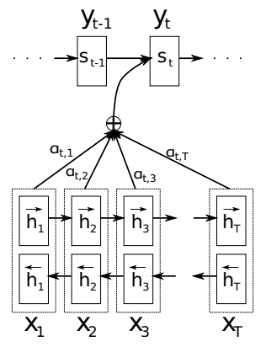






Attention and RNNs
Bahdanau, Dzmitry, Kyunghyun Cho, and Yoshua Bengio. "Neural machine translation by jointly learning to align and translate." arXiv preprint arXiv:1409.0473 (2014).

Slide 14
Attention and RNNs
RNN
Bahdanau, Dzmitry, Kyunghyun Cho, and Yoshua Bengio. "Neural machine translation by jointly learning to align and translate." arXiv preprint arXiv:1409.0473 (2014).

Slide 15
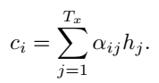
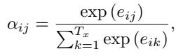

Attention and RNNs
RNN
Self-attention + RNN
Bahdanau, Dzmitry, Kyunghyun Cho, and Yoshua Bengio. "Neural machine translation by jointly learning to align and translate." arXiv preprint arXiv:1409.0473 (2014).

Slide 16
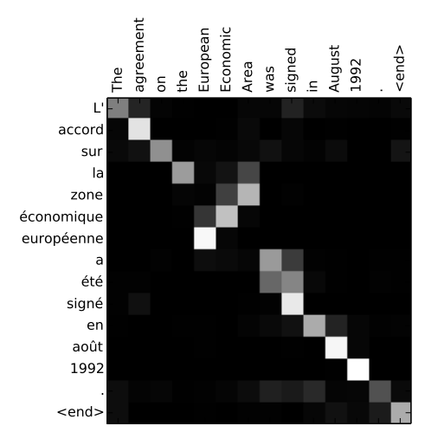
Attention and RNNs
RNN
Self-attention + RNN
Bahdanau, Dzmitry, Kyunghyun Cho, and Yoshua Bengio. "Neural machine translation by jointly learning to align and translate." arXiv preprint arXiv:1409.0473 (2014).

Slide 17


Attention and RNNs
RNNs
Computation cost
Sequential (not parallel)
BPTT (retain computation graph)
Alternative way to capture word dependency

Slide 18








Transformers
Vaswani, Ashish, et al. "Attention is all you need." Advances in neural information processing systems 30 (2017).

Slide 19



GPT (Generative Pre-Training)
Auto-regressive,
Decoder language model
Radford, Alec, et al. "Improving language understanding by generative pre-training." (2018).

Slide 20
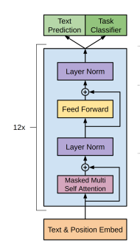



GPT (Generative Pre-Training)
Auto-regressive,
Decoder language model
Radford, Alec, et al. "Improving language understanding by generative pre-training." (2018).

Slide 21

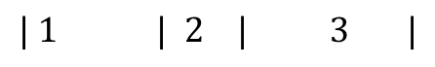

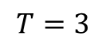





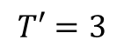
GPT
$$| 1 | 2 | 3 |$$
$$|1 \left| 2 \right| 3 |$$
|Answer | the | following |
|the | following | question |
$$T=3$$
$$T′=3$$
Vaswani, Ashish, et al. "Attention is all you need." Advances in neural information processing systems 30 (2017).

Slide 22
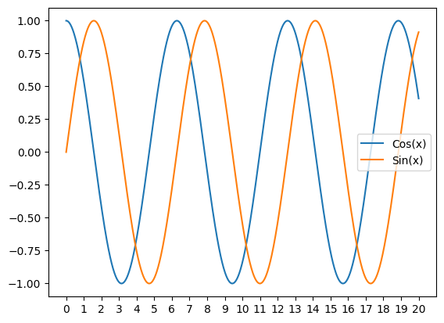
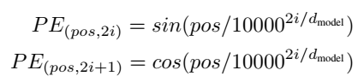

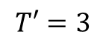

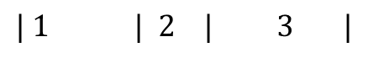



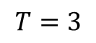





GPT
$$| 1 | 2 | 3 |$$
$$|1 \left| 2 \right| 3 |$$
|Answer | the | following |
|the | following | question |
$$T=3$$
$$T′=3$$
Vaswani, Ashish, et al. "Attention is all you need." Advances in neural information processing systems 30 (2017).

Slide 23




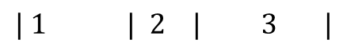

GPT
$$T=3$$
$$d_{model}=10$$
$$| 1 | 2 | 3 |$$
|Answer | the | following |
Position embedding
[[ 0. 1. 0. 1. 0. 1. 0. 1. 0. 1. ]
[ 0.84 0.54 0.16 0.99 0.03 1. 0. 1. 0. 1. ]
[ 0.91 -0.42 0.31 0.95 0.05 1. 0.01 1. 0. 1. ]]
Notes:
Vector for 1st, 2nd, and 3rd words

Slide 24






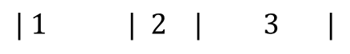
GPT
$$T=3$$
$$d_{model}=10$$
$$vocab size=6$$
$$| 1 | 2 | 3 |$$
|Answer | the | following |
Input Embedding
Answer
Following
Here
Please
Question
The
[[-0.68 0.49 -0.08 0.57 0.22 -0.19 0.53 -1.19 0.75 -0.19]
[ 0.09 0.04 -0.39 0.27 1.03 -0.01 0.07 -0.47 1.21 -0.28]
[ 1.2 0.09 -0.44 0.12 0.06 0.08 1. -0.64 -0.52 0.05]
[-1.28 -1.38 -0.26 -1.5 0.93 0.16 0.56 1.84 -0.41 -1.45]
[-0.43 0.09 0.67 -0.06 -1.52 1.78 0.5 -1.38 -0.47 -2. ]
[-0.8 0.54 1.66 -0.55 1.2 -2.73 1.02 -0.25 -0.36 -1.85]]
Notes:
Vector for 1st, 2nd, and 3rd words

Slide 25
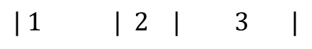
GPT
$$| 1 | 2 | 3 |$$
$$T=3$$
$$d_{model}=10$$
$$vocab size=6$$
+
|Answer | the | following |
Answer
The
Following
[[-0.68 0.49 -0.08 0.57 0.22 -0.19 0.53 -1.19 0.75 -0.19]
[-0.8 0.54 1.66 -0.55 1.2 -2.73 1.02 -0.25 -0.36 -1.85]
[ 0.09 0.04 -0.39 0.27 1.03 -0.01 0.07 -0.47 1.21 -0.28]]
Input Embedding
+
Position Embedding
+
1
2
3
[[ 0. 1. 0. 1. 0. 1. 0. 1. 0. 1. ]
[ 0.84 0.54 0.16 0.99 0.03 1. 0. 1. 0. 1. ]
[ 0.91 -0.42 0.31 0.95 0.05 1. 0.01 1. 0. 1. ]]
Notes:
Vector for 1st, 2nd, and 3rd words

Slide 26




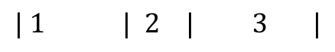
GPT
Answer
The
Following
[[-0.68 0.49 -0.08 0.57 0.22 -0.19 0.53 -1.19 0.75 -0.19]
[-0.8 0.54 1.66 -0.55 1.2 -2.73 1.02 -0.25 -0.36 -1.85]
[ 0.09 0.04 -0.39 0.27 1.03 -0.01 0.07 -0.47 1.21 -0.28]]
$$| 1 | 2 | 3 |$$
+
|Answer | the | following |
1
2
3
[[ 0. 1. 0. 1. 0. 1. 0. 1. 0. 1. ]
[ 0.84 0.54 0.16 0.99 0.03 1. 0. 1. 0. 1. ]
[ 0.91 -0.42 0.31 0.95 0.05 1. 0.01 1. 0. 1. ]]

Slide 27
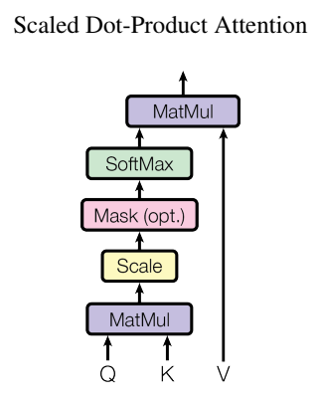
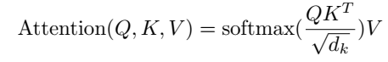
Self-attention
Vaswani, Ashish, et al. "Attention is all you need." Advances in neural information processing systems 30 (2017).

Slide 28





Self-attention
Query
Key
Value
Projections of input
Vaswani, Ashish, et al. "Attention is all you need." Advances in neural information processing systems 30 (2017).

Slide 29
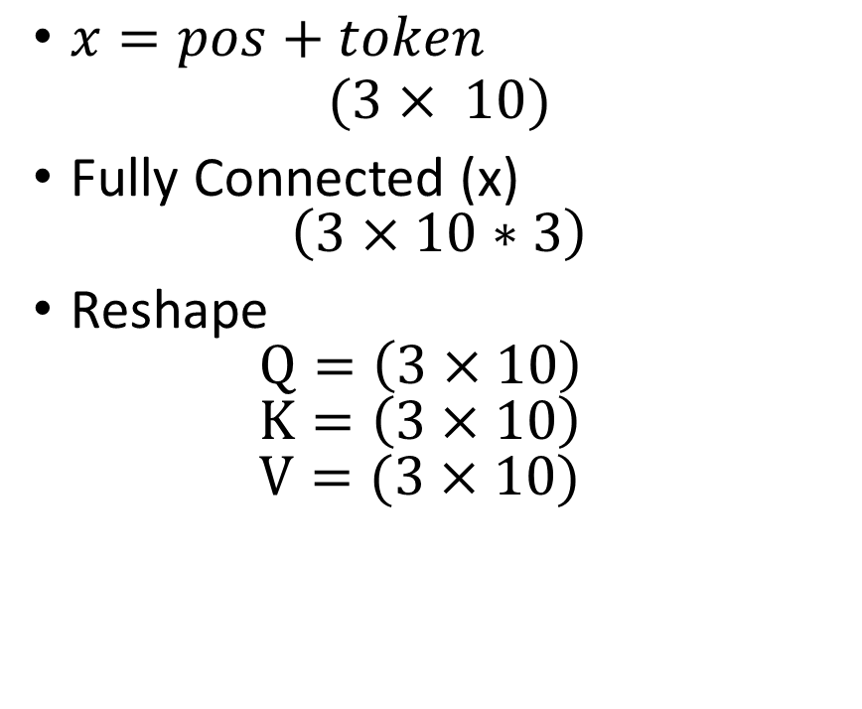
Self-attention
Q
K
V
[[ 0.84 1.22 -0.1 0.68 -0.11 -0.54 -0.54 -0.74 -0.71 0.09]
[-0.42 1.38 0.96 1.87 -0.58 0.05 0.45 -1.06 0.21 -1.24]
[-0.19 0.33 -1.1 -0.27 -0.64 0.75 -0.42 0.51 -1.44 -0.48]]
$x=pos+token$ $(3× 10)$
Fully Connected (x) $\left(3×10∗3\right)$
Reshape $Q=\left(3×10\right)$ $K=\left(3×10\right)$ $V=(3×10)$
[[ 0.16 -1.08 -0.9 0.33 -0.65 -0.09 0.83 -0.3 0.51 -0.03]
[-0.22 -0.74 -1.61 0.89 1.08 1.66 0.2 1.18 0.24 -1.74]
[ 0.15 0.49 0.43 0.16 -1.04 -0.7 0.33 -0.61 0.94 0.5 ]]
[[ 0.54 -0.7 0.14 0.96 -0.74 -0.04 0.11 0.33 -0.03 0.6 ]
[-0.02 0.49 1.3 1.81 -0.94 -0.6 -0.02 1.24 -0.47 0.89]
[-0.04 -1.8 -0.44 -0.74 0.05 0.19 0.35 -0.85 -0.43 0.03]]

Slide 30


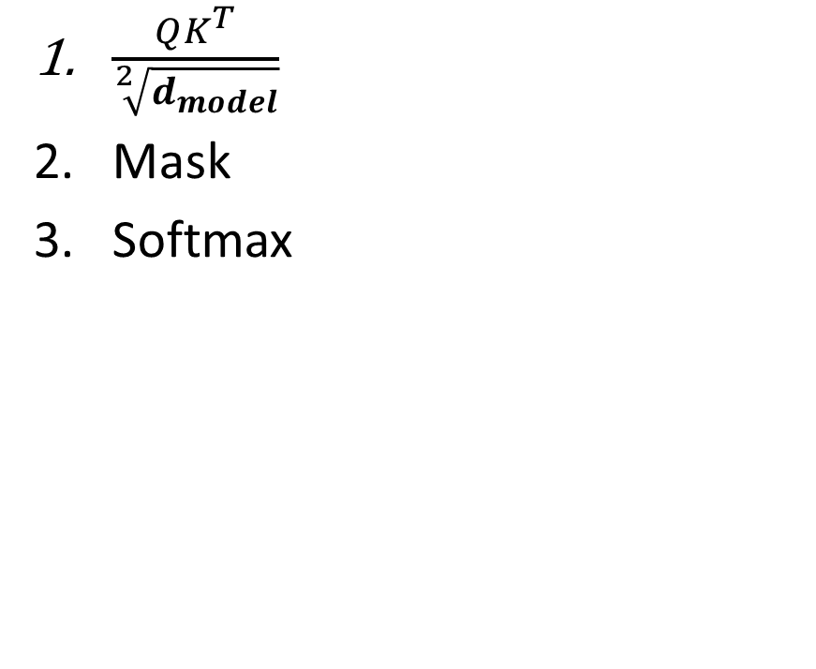






Self-attention
$\frac{QK^{T}}{\sqrt[2]{d_{model}}}$
Mask
Softmax
[[-0.42 -0.83 0.29]
[-0.19 -0.1 0.71]
[-0.12 0.92 -0.73]]
[[-0.42 -inf -inf]
[-0.19 -0.1 -inf]
[-0.12 0.92 -0.73]]
[[1. 0. 0. ]
[0.48 0.52 0. ]
[0.23 0.65 0.13]]

Slide 31

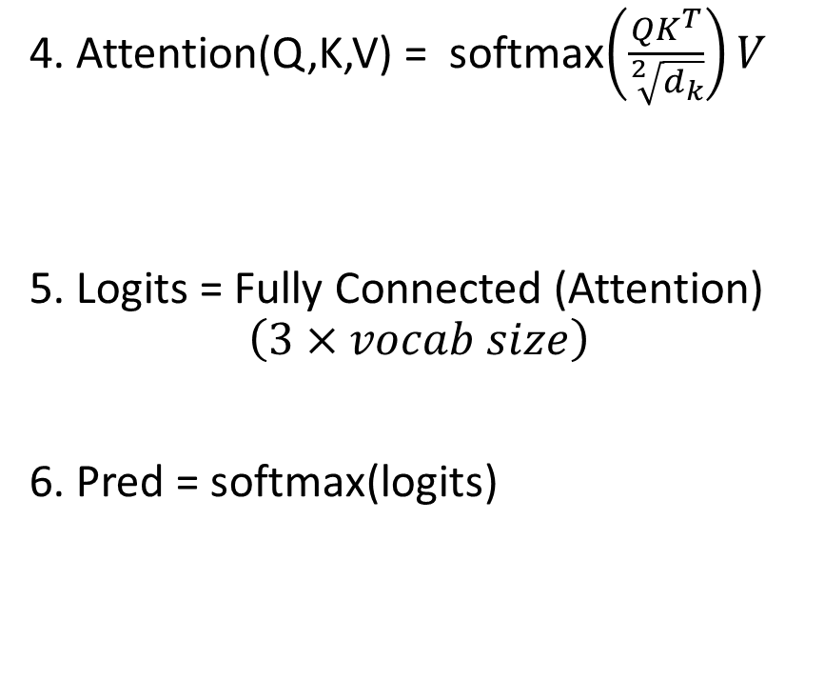
Self-attention
4. Attention(Q,K,V) = softmax$\left(\frac{QK^{T}}{\sqrt[2]{d_{k}}}\right)V$
5. Logits = Fully Connected (Attention) $$\left(3×vocab size\right)$$
6. Pred = softmax(logits)
4.
5.
6.
[[ 0.54 -0.7 0.14 0.96 -0.74 -0.04 0.11 0.33 -0.03 0.6 ]
[ 0.24 -0.08 0.75 1.4 -0.84 -0.33 0.04 0.81 -0.26 0.75]
[ 0.1 -0.07 0.82 1.3 -0.77 -0.37 0.06 0.77 -0.36 0.72]]
[[ 0.27 0.04 -0.69 0.35 -0.04 -0.38]
[ 0.44 -0.11 -0.84 0.29 -0.43 -0.23]
[ 0.51 -0.1 -0.83 0.27 -0.45 -0.15]]
[[0.22 0.18 0.08 0.24 0.16 0.12]
[0.27 0.16 0.08 0.24 0.12 0.14]
[0.29 0.15 0.08 0.23 0.11 0.15]]

Slide 32


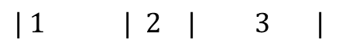

Self-attention
$$| 1 | 2 | 3 |$$
$$|1 \left| 2 \right| 3 |$$
6. Pred = softmax(logits)
6.
|Answer | the | following |
|the | following | question |
1. Answer
2. Following
3. Here
4. Please
5. Question
6. The
[[0.22 0.18 0.08 0.24 0.16 0.12]
[0.27 0.16 0.08 0.24 0.12 0.14]
[0.29 0.15 0.08 0.23 0.11 0.15]]

Slide 33
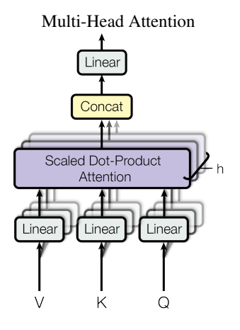









Multi-head attention
Vaswani, Ashish, et al. "Attention is all you need." Advances in neural information processing systems 30 (2017).

Slide 34





GPT (Generative Pre-Training)
Auto-regressive,
Decoder language model
Radford, Alec, et al. "Improving language understanding by generative pre-training." (2018).

Slide 35
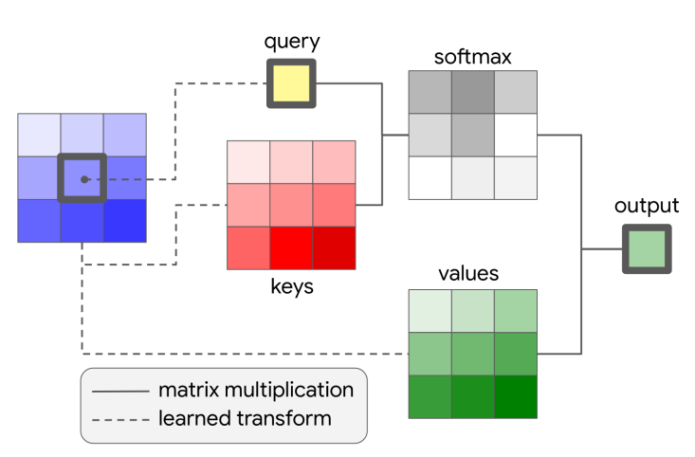


Attention to Vision
Ramachandran, Prajit, et al. "Stand-alone self-attention in vision models." Advances in neural information processing systems 32 (2019).

Slide 36




Vision Transformers
Dosovitskiy, Alexey, et al. "An image is worth 16x16 words: Transformers for image recognition at scale." arXiv preprint arXiv:2010.11929 (2020).

